Slide 1
Implementation of Procedure To Convert Pushdown Automata To Context-Free Grammar
By. Mateus A. Fernandes A.
April 22, 2020

Slide 2
Pushdown Automata (PDA)
Automaton/machine that represents Context-Free Languages.
Uses a single stack as storage mechanism.
It is more powerful than Finite Automata.

Slide 3
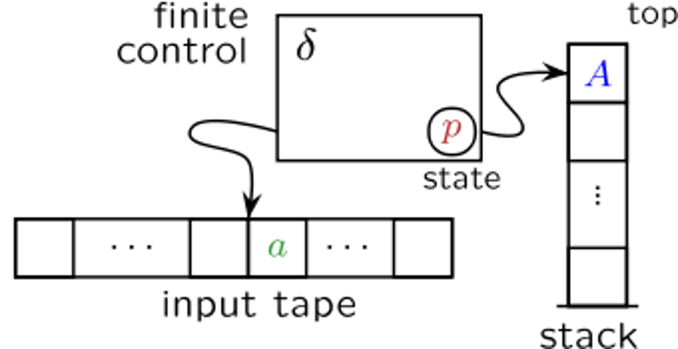
Pushdown Automata (PDA)
PDA Elements:
M = (Q, Σ, Γ, δ, q₀, Z, F)
Where:
control unit
top
δ
A
Q = set of states,
Σ = input alphabet,
Γ = stack alphabet,
δ = transition function from Q×(Σ ∪ {λ})×Γ to the set of subsets of Q×Γ *,
q₀ = initial state (q₀ ∈ Q),
Z = stack start symbol (Z ∈ Γ),
F = set of final states (F ⊆ Q).
q
state
a
Z
input file
stack

Slide 4
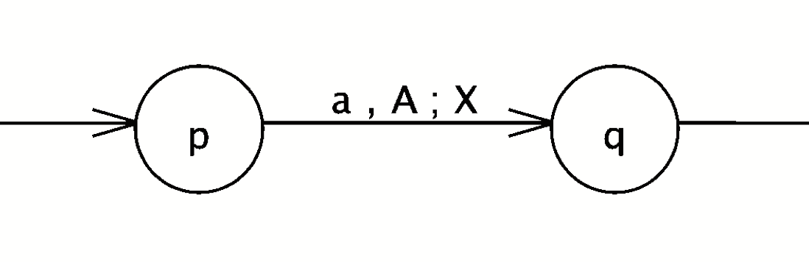
Pushdown Automata (PDA)
Transition rule:
δ(p, a, A) = {(q, X)}
Where:
p = current state (p ∈ Q),
a = an input symbol (q ∈ Σ ∪ {λ}),
A = a symbol to pop from top of stack (X ∈ Γ ),
q = next state to transition to (q ∈ Q),
X = string of symbols to push on top of stack (X ∈ Γ *).

Slide 5
Context-Free Grammar (CFG)
Grammar that represents Context-Free Languages.
Grammar = set of recursive written rules (or productions) used to generate patterns of strings for some formal language.

Slide 6
Context-Free Grammar (CFG)
CFG Elements:
G = (V, T, S, P)
Where:
V = set of variables (disjoint to T),
T = set of terminal symbols (often T = Σ),
S = start variable (S ∈ V),
P = set of productions of the form:
A → x
A = a variable (A ∈ V),
x = string of terminals and/or variables (x ∈ (V ∪ T)*)
Where:

Slide 7
Context-Free Grammar (CFG)
Variables based on PDA elements
[pAq]
Where:
p = current state on PDA (p ∈ Q),
q = end state that PDA will be transitioned to (p ∈ Q),
A = PDA stack symbol that gets pop (A ∈ Γ)
[pAq] represents sequences of moves that take PDA from state p to q and ultimately removes A from the stack.

Slide 8
PDA to CFG Conversion
Preliminary Step
PDA must be configured to accept input string by empty stack

Slide 9
PDA to CFG Conversion
PDA transition rules to CFG productions
If δ(p, a, A) contains (q, λ)
then, production in the form:
[pAq] → a
If δ(p, a, A) contains (q, Y₁Y₂Y₃ … Y_{k}) for (k ≥ 1)
then, family of productions in the form:
[pAs_{k}] → a[qY₁ s₁][s₁Y₂ s₂][s₂Y₃ s₃] … [s_{k-2}Y_{k-1} s_{k-1}][s_{k-1}Y_{k} s_{k}]
where: s_{i} = any possible state in Q

Slide 10
PDA to CFG Conversion
Getting Starting Productions
Unknown final state because its acceptance by empty stack
Then, family of productions in the form:
S→ [q₀ Zq]
where: q = any possible state in Q

Slide 11
Additional Simplification Steps
Eliminate useless productions!
Productions with undefined variables
S → aA | aAB
A → b
Variables that do not reach to terminal string
S → bAa
A → aA
Non-reachable variables from starting
S → aA
A → aC
B → cA | λ
C → cC | λ
Also, combine equivalent LHS variables!
S → aA
A → b
S →
Empty Language
S → aA
A → aC
C → cC | λ

Slide 12
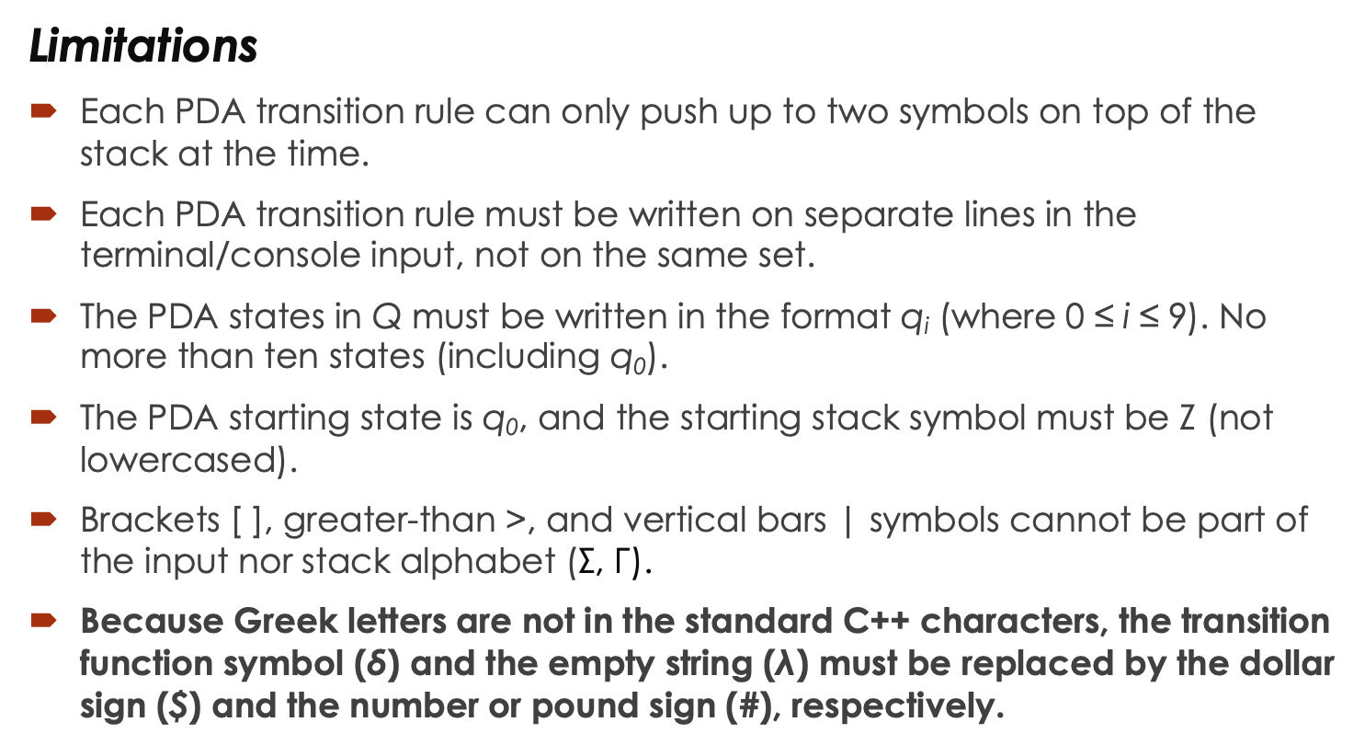
Implementations (CODE)
Limitations
Each PDA transition rule can only push up to two symbols on top of the stack at the time.
Each PDA transition rule must be written on separate lines in the terminal/console input, not on the same set.
The PDA states in Q must be written in the format q_{i} (where 0 ≤ i ≤ 9). No more than ten states (including q₀).
The PDA starting state is q₀, and the starting stack symbol must be Z (not lowercased).
Brackets [ ], greater-than >, and vertical bars | symbols cannot be part of the input nor stack alphabet (Σ, Γ).
Because Greek letters are not in the standard C++ characters, the transition function symbol (δ) and the empty string ($\text{λ}$) must be replaced by the dollar sign ($) and the number or pound sign (#), respectively.

Slide 13
Implementations (CODE)
Demonstration
Code file: pda_to_cfg.cpp

Slide 14
Further Code Developments
Reduce code limitations.
Allow also PDA configurations of acceptance by final state.
Provide a more graphical user interface (GUI) or equivalent.

Slide 15
References
P. Linz, An Introduction to Formal Languages and Automata, 6th ed. Burlington, MA, USA: Jones & Barlett Learning, 2017.
J. C. Martin, Introduction to Languages and the Theory of Computation, 4th ed. New York, NY, USA: McGraw-Hill, 2011. [Online]. Available: http://citeseerx.ist.psu.edu/viewdoc/download?doi=10.1.1.465.3774&rep =rep1&type=pdf. Accessed: Apr. 22, 2020

